Slide 1



Agents in Artificial Intelligence
A complete, beginner-friendly guide to understanding intelligent agents
Prepared by
Bh.Sai Ganesh,
(Asst.Prof),
Aditya University

Slide 2
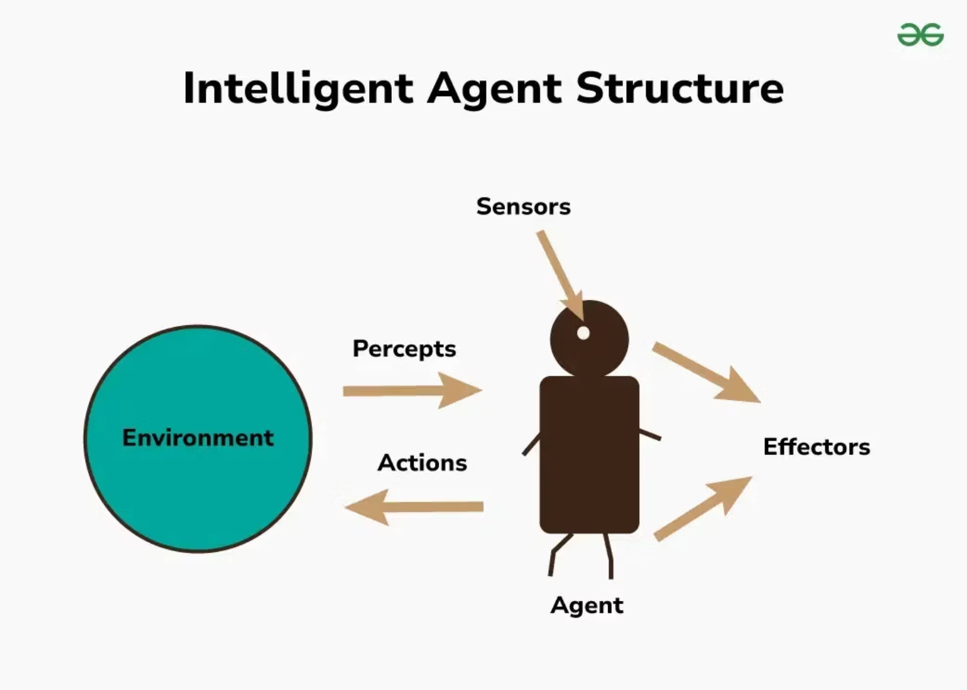


What Is an Agent?
An agent is anything that continuously perceives its environment through sensors and acts upon it using actuators. Think of it as a simple loop:
Sense → Think → Act → Repeat
This fundamental cycle, called the Perception-Action Cycle, forms the basis of all intelligent behaviour in artificial intelligence systems.

Slide 3
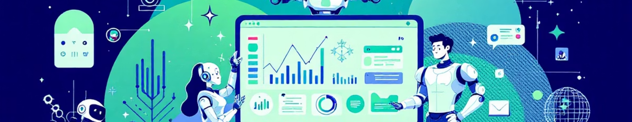





Examples of Agents All Around Us
Human Agent
Robot Agent
Software Agent
Sensors: Eyes, ears, touch
Sensors: Camera, GPS, lidar
Sensors: User inputs, system data
Actuators: Hands, legs, voice
Actuators: Wheels, robotic arms
Actuators: Outputs, search results

Slide 4

What Makes an Agent Intelligent?
An intelligent agent doesn't simply react blindly to stimuli. Instead, it demonstrates sophisticated behaviour through five key capabilities:
01
02
03
Collects Information
Understands Situations
Chooses Best Actions
Gathers data from sensors and environment
Processes and interprets the information
Evaluates possible responses intelligently
04
05
Maximises Performance
Works Autonomously
Aims to achieve optimal outcomes
Operates independently without constant human guidance

Slide 5



Agent Architecture: Two Essential Components
Architecture
Agent Programme
The physical or software platform that provides the foundation:
The logic, code, and AI models that drive decisions:
Algorithms and rules
Robot hardware and sensors
Learning models
Computer systems
Decision-making logic
Network infrastructure
Knowledge representation
Processing capabilities
Together, these two components create a truly intelligent agent capable of sophisticated behaviour.

Slide 6

Understanding the Environment
The environment encompasses everything an agent interacts with—from game boards to city roads to user interfaces. Understanding environmental properties is crucial for choosing the right agent type.
Property
Meaning
Example
Fully Observable
Agent sees all needed information
Chess board
Partially Observable
Agent has incomplete information
Driving in fog
Deterministic
Same action yields same result
Digital calculator
Stochastic
Uncertainty exists in outcomes
Road traffic
Episodic
No link between separate tasks
Image classification
Sequential
Current actions affect future
Playing chess

Slide 7
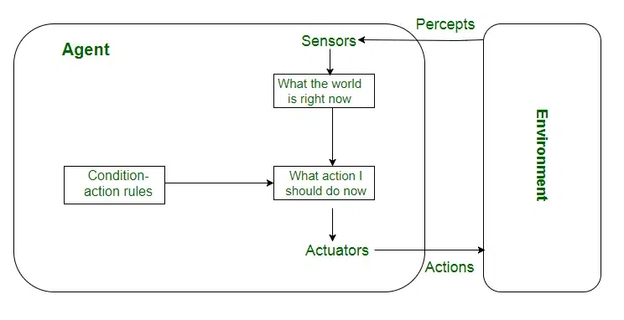

The Five Types of Intelligent Agents
From simple reactive systems to sophisticated learning machines, agents exist on a spectrum of increasing intelligence and complexity. Each type serves specific purposes and environmental conditions.

Slide 8







Agent Types: From Simple to Sophisticated
Simple Reflex Agents
React immediately to current conditions using if-then rules. No memory of past or consideration of future.
Example: thermostat turning on heating.
Model-Based Reflex
Like simple reflex but maintain internal memory of world state. Can work in partially observable environments.
Example: robot remembering obstacle locations.
Goal-Based Agents
Have explicit goals and plan actions to achieve them. Compare different paths and select best option.
Example: navigation system planning optimal route.
Utility-Based Agents
Maximise utility or "happiness" by handling complex trade-offs between speed, safety, cost.
Example: self-driving car choosing safest and fastest route.
Learning Agents
Learn from experience and improve over time. Adapt without being programmed for every situation.
Example: AI assistants improving with usage.

Slide 9

Comparing Agent Capabilities
Agent Type
Memory
Goals
Utility
Learning
Best Use Case
Simple Reflex
❌
❌
❌
❌
Simple environments
Model-Based
✔
❌
❌
❌
Partially observable tasks
Goal-Based
✔
✔
❌
❌
Planning and problem-solving
Utility-Based
✔
✔
✔
❌
Decision-making with trade-offs
Learning
✔
✔
✔
✔
Adaptive real-world tasks
Complexity and capability increase as we move from simple reflex agents to learning agents, with each type building upon the capabilities of those before it.

Slide 10



Why Understanding Agents Matters
Foundation of AI
Universal Framework
Agents form the conceptual basis for understanding all artificial intelligence systems, from simple automata to complex neural networks.
All advanced AI systems—chatbots, self-driving cars, game players—can be understood through the agent paradigm.
Practical Applications
This knowledge enables you to design, analyse, and improve real-world AI solutions across countless domains and industries.
Remember: An agent senses, thinks, and acts. Intelligence means choosing the best actions. Master these concepts, and you've mastered the foundation of artificial intelligence.

